Slide 1
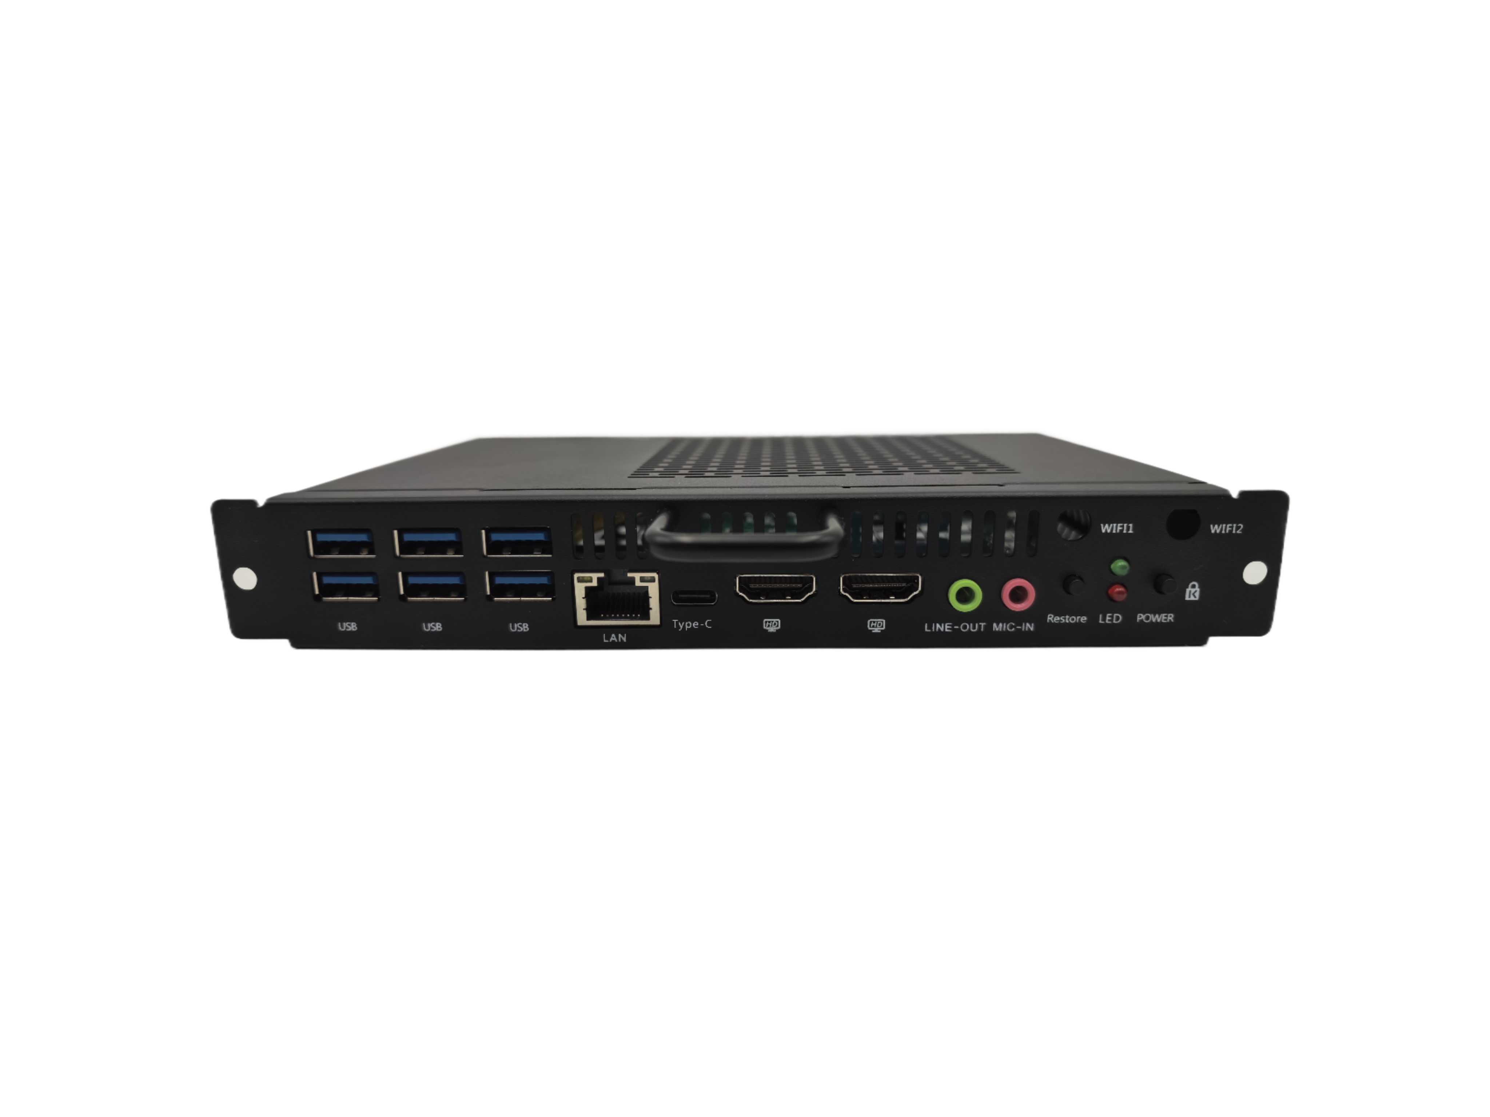





Datasheet OPS
The product features
Support onboard Intel® Core™ 13/14th HX i5/I7 processor
Type-C: supports USB data transmission and (4k60hz) video display
IO port dual HDMI + JAE 80PIN HDMI all channels support 4K60hz output
Support dual-channel SO-DIMM DDR4 memory and dual M.2 2280 SSD storage
Support BIOS scheduled boot, power-on boot, PXE boot
Support TPM2.0
Specification
Standard parameters | CPU | I7-14650HX, Onboard Intel® Core™ 14th HX processor
 | RAM | 16G, 2* SO-DIMM DDR4 2666/3200MHz Memory
 | Storage | 512G, SSD 2*M.2 2280 interface support NVMe and SATA dual protocols (adaptive switching)
 | GPU | Intel® UHD Graphics
 | Display output | HDMI/HDMI2/80Pin HDMI support synchronous dual display/asynchronous triple display
 | Network | LAN | 1* 8111H 10M/100M/1000M Ethernet
 |  | WIFI | 1*M.2 2230 for Wifi+BT
I/O | Front interface | 2*HDMI2.0 out(4K/60Hz); 6*USB3.2 Gen 2; 1* RJ45; 1*Power; 1* Reset; 1*Line out; 1*Mic in; 1*Type-C (USB data transmission and video display)
 | Rear interface | 1*JAE 80PIN: HDMI2.0 out(4K/60Hz)
Power | Input | 12V/19V(70±5W)
Size | Host size (mm) | Bare: 119*180*30mm |  | Packing size: 280*200*70mm
 | Weight (kg) | Net ≈0.8 Kg Gross ≈1 Kg
Temperature and humidity | Operating temp | 0°C~ 45°C
 | Storage temp | -40°C~ 80°C
 | Working humidity | 10% - 95% @40°C No condensation
OS | Support | Windows 10/11, Linux

